Slide 1


Electrical Machinery Fundamentals
EE 250 SPRING 2020
Lecture 3
Instructor: Dr. Aashir Waleed

Slide 2
Chapter 5 Direct-Current Motors

Slide 3
5.1 Counter-electromotive force (cemf)
DC machine can operate either as a motor or as a generator
Armature connected to a dc source E_{s}
Armature starts rotation => Generator effect produces => E_{o} is induces in armature conductor when they cut the flux
In motors: Induced voltage E_{o} is called CEMF
Net voltage acting in a series circuit:

Slide 4
5.2 Acceleration of motors
When motor is running:
When motor is not running:
Starting current is 20,30 times higher than that of nominal full-load current of motor
As motor speeds up , counter voltage is induced and current through armature windings falls
At no-load: E_{o} is slightly less than E_{s}?

Slide 5
5.3 Mechanical Power and Torque
Power:

Slide 6
5.3 Mechanical Power and Torque
Torque:
Numerical Practice 5.2

Slide 7
5.4 Speed of rotation

Slide 8
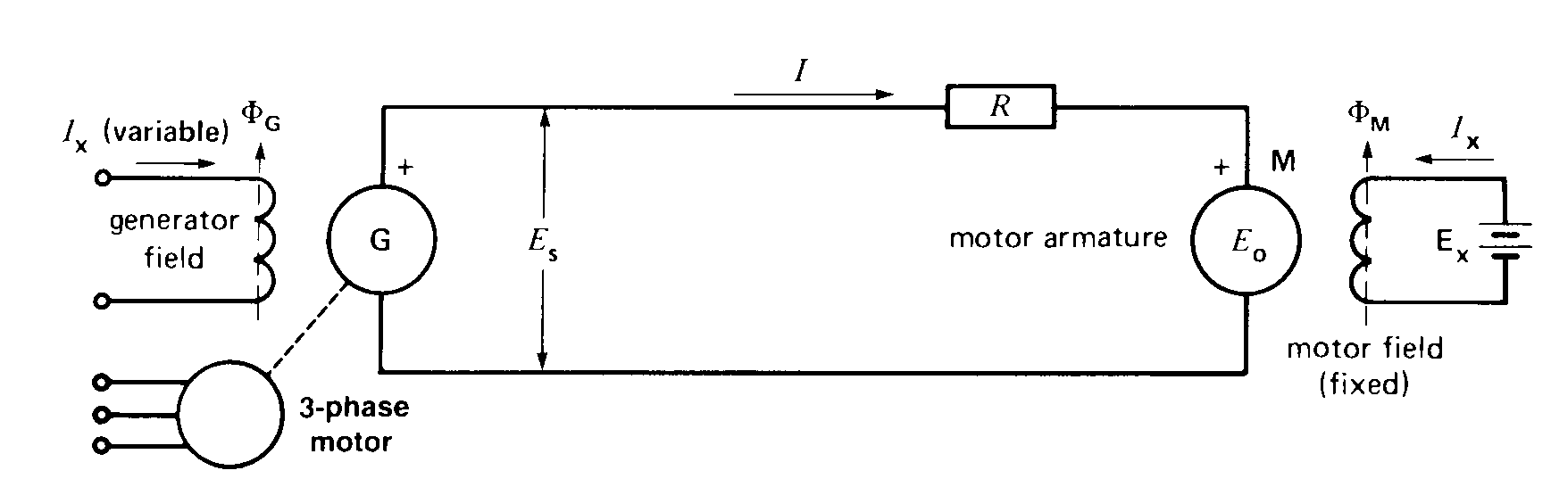
5.5 Armature speed control
Variable field excitation
Fixed field excitation
Ward-Leonard system
Power can be recovered
How?
Source voltage and speed control:
G as a generator
G as a motor
3-Phase motor as a asynchronous generator
Application: Steel mills , High-rise elevators , Mines and Paper mills
Current reverses when E_{o}>E_{s}

Slide 9
5.5 Armature speed control
Rheostat speed control:
Rheostat in series with armature
Only preferable in small motors due to losses across rheostat

Slide 10
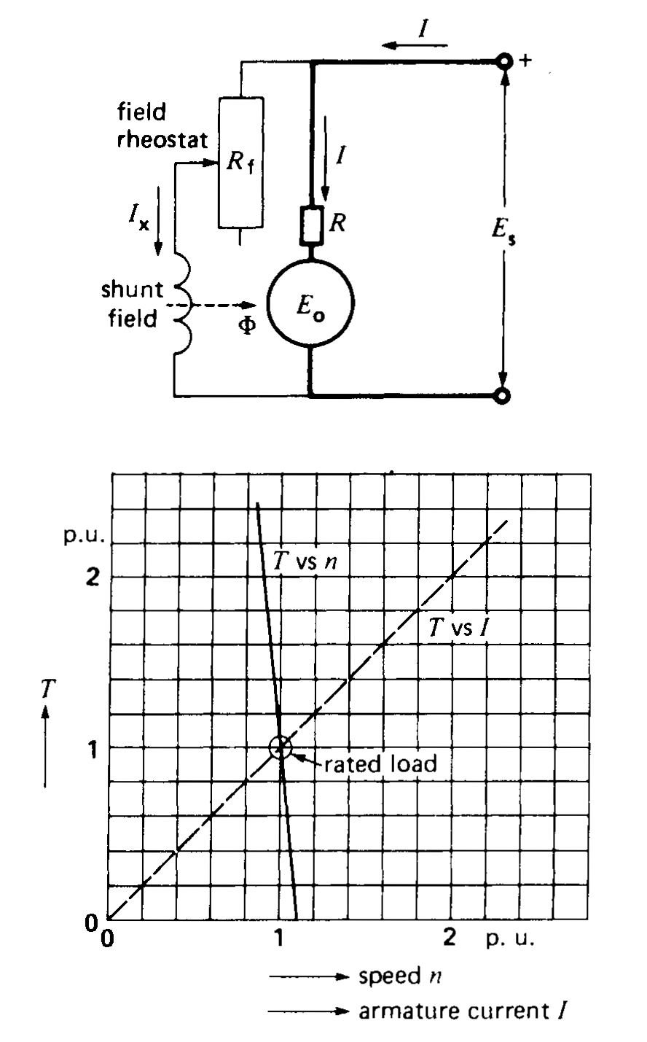
5.6 Field speed control
This method is used when motor has to run above its rated speed
To control field we use a field rheostat
Motor have to turn faster to achieve small difference between source and induced voltage => In this way motor can be run above its nominal speed by introducing field rheostat
Flux must not drop to dangerously low level => Rheostat value must be set accordingly

Slide 11
5.7 Shunt motor under load
Mechanical load application results in less torque production due to small no-load current => Motor begins to slow => cemf to diminish => higher current => higher torque
Motor speed will become constant when: Torque by motor=Torque imposed by mechanical load

Slide 12
5.8 Series motor
Similar to shunt motor in construction except field windings that are connected in series with armature and carry full armature current
Properties of series motor are different from shunt motor
In shunt: Flux per pole remains constant at all loads as shunt field is connected to the line
In series: Flux per pole depends upon the armature current and thus upon the load.
Large load current=> Large flux and vise versa
Starting torque of series motor > Starting torque of shunt motor

Slide 13
5.8 Series motor
Starting torque of series motor > Starting torque of shunt motor
Flux per pole is same as shunt at Full-load.
but at start starting current is high in series which results in high starting torque.
Never operate Series motor at no-load or less than full-load.
Less load current results in weaker flux and very high dangerous speeds.

Slide 14
5.9 Series motor speed control
Increase in speed: By adding a low resistance in parallel with series field under load condition.
field current is smaller than before => drop in flux => speed increases
Decrease in speed: By adding resistance in series with field and armature. Voltage drops across resistor and field reduces armature voltage supply and thus speed falls.

Slide 15
5.9 Series motor speed control

Slide 16
5.10 Applications of series motor
1. Used on equipment requiring high starting torques .
2. Used for devices that run at high speed with light loads.
3. High torque is accompanied by low speed and vise versa.

Slide 17
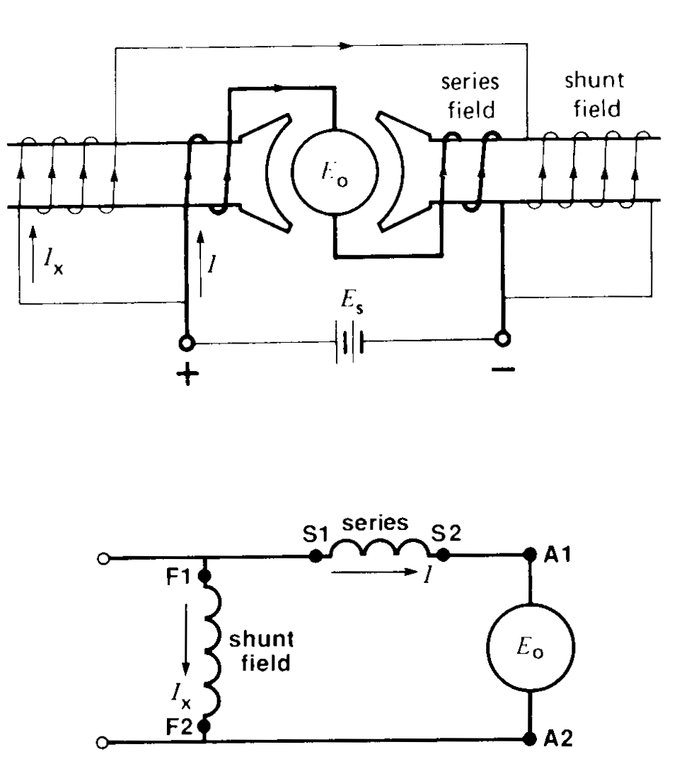
5.11 Compound motor
Have both series and shunt field
In cumulative compound both field add.
Shunt field is always stronger than that of series field
At no-load: I in series winding is low and shunt field is fully excited. So, motor behaves as shunt machine
At load: mmf of series field increases and mmf of shunt remains constant and thus total mmf is higher at loading than that of no-load
Motor speed falls with increasing load
How to obtain differential compound motor?

Slide 18
5.11 Torque-Speed curve for different motors
Differential Compound
Speed increases with increasing load, lead to instability
It has few applications

Slide 19
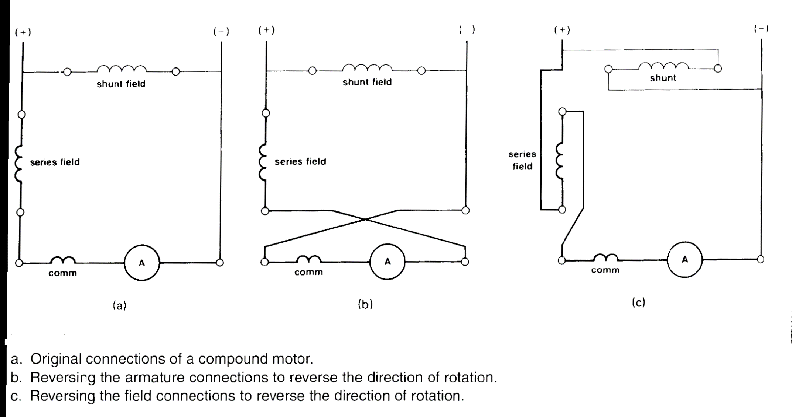
5.12 Reversing the direction of rotation

Slide 20
5.13 Starting a shunt motor
If we apply full voltage to a stationary shunt motor, starting current in shunt motor will be very high and we may have following risks:
Burning out the armature
Damaging of commutator and brushes due to heavy sparking
Overloading the feeder
Snapping off the shaft due to mechanical shock
All DC machines therefore are provided a mean to limit the starting current to reasonable values
One way is to introduce rheostat with the armature=> resistance reduces as motor accelerates and then eliminated entirely when machines starts running at full speed

Slide 21
5.14 Face-plate starter
Contact arm moves from dead position M to last contact gradually when speed rises at one contact ceases to rise further
Any cut of in excitation current leads to release of contact arm to its initial dead position under the pull of spring

Slide 22
5.15 Stopping a motor
When a DC machine is coupled to heavy inertial load then it may takes hours or more to stop
Due to this unacceptable situation we must apply some stopping mechanism that may be braking torque to ensure rapid stop
One way is to apply mechanical friction just like stopping of a car
Circulating reverse current for electrical braking
Two methods are used for electromechanical braking:
Dynamic braking
Plugging

Slide 23
5.16 Dynamic braking
Consider a shunt motor whose field and armature are connected to same source and armature is consist of double through switch
Motor acts as generator when its switch is opened or connected to R
The reverse torque due to current I₂ brings the motor to rapid and smooth stop

Slide 24
5.17 Plugging
We can stop motor rapidly by a method called plugging
In this method we change the terminals of armature to flow reverse current through it
Under normal conditions
On reversal of terminals of source the net voltage becomes:
cemf will now adds to supply voltage and will create enormous reverse current (50 times than that of armature current) that can destroy segments , brushes and supports even before line circuit breakers open
To overcome this problem we introduces reverse current limiting resistor

Slide 25
5.17 Plugging
Motor speed starts reducing until completely stops
At stop Eo=0 and I=Es/R
We must open the circuit as motor comes to halt otherwise it will start turning in opposite direction.
Null speed device is mounted for this purpose

Slide 26
Dynamic braking vs. Plugging
Plugging is faster.
Dynamic breaking is more popular due to simplicity

Slide 27
5.19 Armature reaction
Current flowing in armature conductors creates mmf and this mmf distorts and weakens the field flux, this process of field flux weakening is called armature reaction
Armature reaction takes places in both motors and generators

Slide 28
5.20 Flux distortion due to armature reaction
Motor at no-load: Small current flows through armature=> not affects field flux appreciably
Motor at load: Current through armature will be increased and so the armature flux that will distort field flux
Stabilized-shunt windings: Addition of series field of one or two windings to increase the flux under load to kept the speed in limit

Slide 29
5.21 Commutating poles
Introduction of pair of poles in-between the main field poles to counter the effect of armature reaction is called commutating poles.

Slide 30
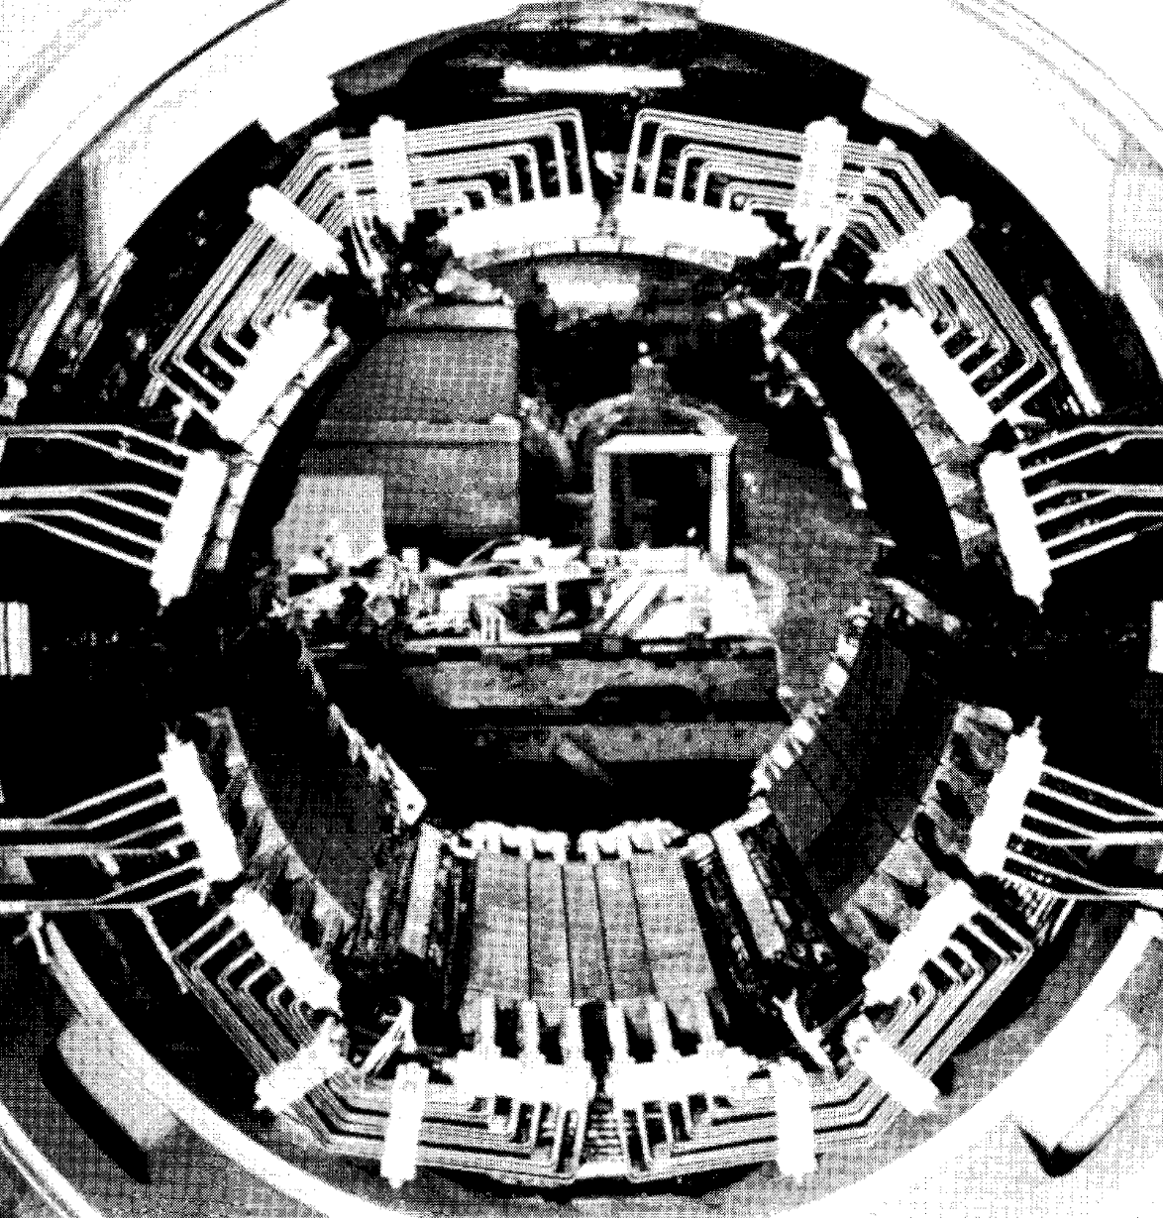
5.22 Compensating Windings
Used in large DC machines that requires abrupt changes
Same function as that of commutating poles and series stabilizing windings
Compensating windings are connected in series with the armature
Produces equal and opposite mmf as that of armature and nullify the affect of armature mmf and thus improves the commutation.

Slide 31
5.24 Permanent magnet motors
Shunt-field motors require coils and field current to produce flux => results in energy losses and large space is required for field poles are disadvantages of shunt-field motors
Solution is : Permanent magnet motors => Small motors have large efficiency
Effective air gap is increased => Less armature reaction => Less field distortion => Improved commutation
Disadvantage:
High cost
Inability to achieve high speed by field weakening

Slide 32
Summary
5.1-5.24
Excluding 5.18 and 5.23
Assignment:
Example 5.1-5.5

